Slide 1
Group #1 - Predictive Analysis of Near-Earth Comets using NASA JPL’s Small-Body Database
Troy Allen, Roy Gabriel, Nattakorn Kittisut, Corey Smith & Moe Kyaw Thu (Team Liaison)
Dr. Goldsman
ISYE 6414 - Regression Analysis

Slide 2

Project Overview
The National Aeronautics and Space Administration (NASA) tracks numerous different astronomical phenomena and celestial bodies
NASA’s Goal – Improve our present understanding of Earth based on past data, gain insights into the workings of our universe, and predict potentially catastrophic events
NASA’s Jet Propulsion Laboratory (JPL) focuses substantial effort on tracking, categorizing, and documenting near-Earth asteroids and comets
Analyze relevant physics and predict possible Earth impact
Vast documentation exists for these small-bodies, including 30+ attributes stored within the Small-Body Database Query
This research will attempt to identify algorithmic correlations between orbital parameters related to near-Earth comets (NECs) based on regression techniques learned in this course
https://bgr.com/science/nasa-shares-photo-of-c-2022-e3-comet-streaking-through-space/

Slide 3
Listing of Assessed Attributes
Predictor Variables [units] | Response Variables [units]
Epoch [s] | Orbital Period (P) [yr]
Time of Perihelion [s] | Minimum Orbit Intersection Distance (MOID) [AU]
Eccentricity (e) [-]
Inclination Angle (i) [deg] | Descrptive Variable
Argument of Perihelion (w) [deg] | Object Name [-]
Longitude of Ascending Node (Node) [deg] | Reference [-]
Perihelion Distance (q) [AU] | Source [-]
Aphelion Distance (Q) [AU]

Slide 4
Proposed Research Questions
Which orbital elements best predict the minimum distance between the comet and Earth (MOID)? Are all input parameters significant? Is the MOID impacted more by the orbit eccentricity (e) or its critical angles (i, w, Node)?
Do the minimum (q) and maximum (Q) distances between the comet and the Sun have an impact on the orbital period (P)? Additionally, are these minimum and maximum distance values correlated or do they depend on some or all other orbital elements?
Is there any relationship between the two response variables, MOID and P? Is there a way to predict likelihood and/or frequency of a Near-Earth comet sighting? Provide justifications using the results of the regression analysis.

Slide 5
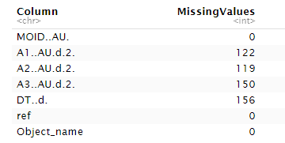
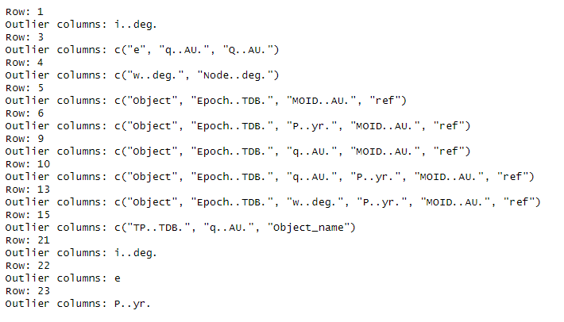
Data Preprocessing
Checking for Missing Values
Some problematic columns existed within our dataset. Namely those for the non-gravitational acceleration parameters in different directions (A1, A2, A3) and the time span of the data arc used (DT).
2. Handling Missing Values
Given the large number of NaN values and the columns’ lack of importance to our analysis, we decided to drop these columns from our dataset.
3. Diagnosis for Outliers
Also wanted to check for outliers and handle them in the case of any problematic observations.

Slide 6
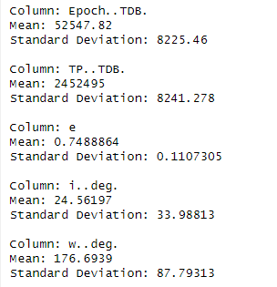
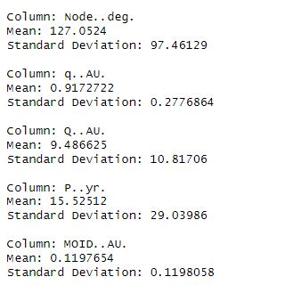
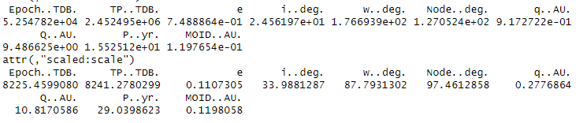
Data Preprocessing
4. Looking at Initial Characteristics
Performed exploratory data analysis to further understand the data’s characteristics and distribution.
5. Standardizing the Data
Created a standardized version of our data in the case that it was needed for a certain type of model.
6. Creating Preliminary Plots
Visualized the relationship between some key features like Eccentricity and Perihelion Distance, Eccentricity and Inclination, and between Perihelion Distance and all orbital elements.

Slide 7
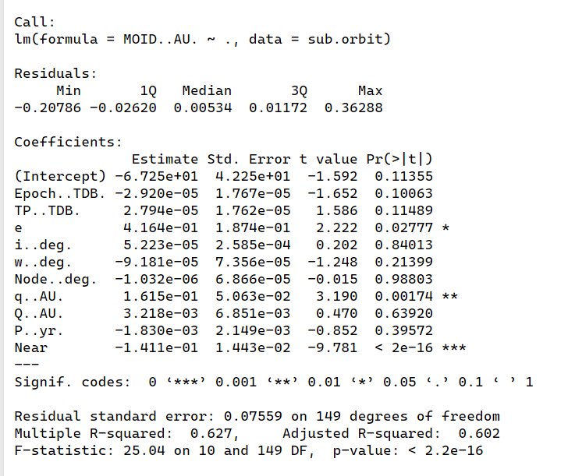
RQ1: Regression Modeling
We found out that variables namely q..AU., Node..deg., w..deg., and e are significant predictor variables.
This means these orbital elements best predict the minimum distance between the comet and Earth (MOID)?
We further conducted model diagnosis focusing on normality testing, nonconstant variance, multicollinearity, and outlier values.
Normality: Not normally distributed residuals
NCV: Presence of heteroskedasticity
Multicollinearity (VIF): Four multicollinearity: Epoch..TDB., TP..TDB., Q..AU., and P..yr.
Cook’s Distance: 5 outlier observations at 5, 158, 6, 22, and 160.
We further conducted stepwise and LASSO regression model for better model performance

Slide 8
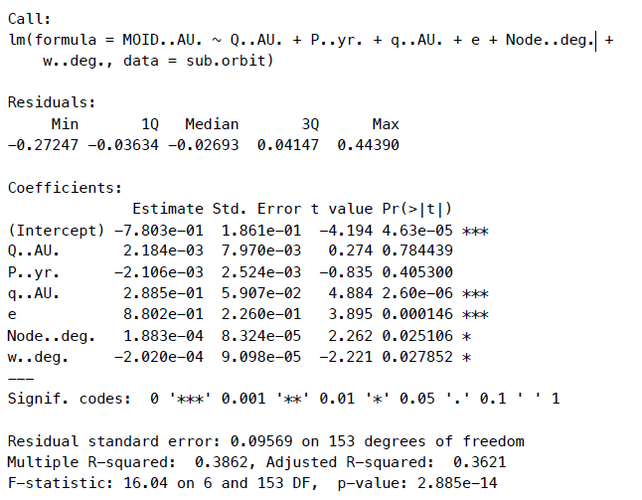
Forward Stepwise Regression
We used the step function to perform forward stepwise regression that we started with a simple model and adding predictors incrementally based on the AIC criterion.
After running the model with the preprocessed data, we get the result from the summary model that:
Selected Variables: Q..AU., P..yr., q..AU., e, Node..deg., w..deg
AIC: -744.09 (This is the lowest AIC score)
Adjusted R-squared: 0.3621
Significant Predictors: q..AU., e, Node..deg., w..deg
These selected variables were found to be significant in predicting the minimum distance between the comet and Earth (MOID).

Slide 9
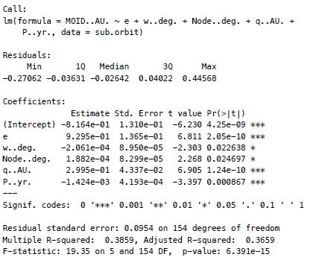
Backward Stepwise Regression
We used the step function to perform backward stepwise regression that we started with a full model and removing predictors incrementally based on the AIC criterion.
After running the model with the preprocessed data, we get the result from the summary model that:
Selected Variables: e, w..deg., Node..deg., q..AU., P..yr.
AIC: -746.01
Adjusted R-squared: 0.3659
Significant Predictors: e, w..deg., Node..deg., q..AU., P..yr.
These selected variables were found to be significant in predicting the minimum distance between the comet and Earth (MOID).

Slide 10
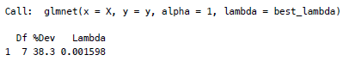
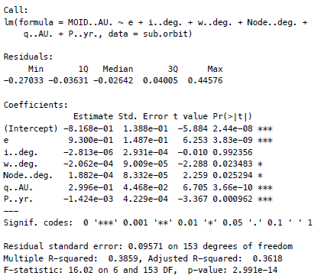
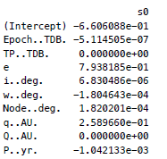
Lasso Regression
We used the glmnet package in R to perform Lasso regression, with cross-validation to select the optimal lambda.
After running the model with the preprocessed data, we get the result from the summary model that:
Selected Variables: P..yr., e., i..deg, w..deg, Node..deg, q..AU.
Lambda: 0.001597953
Adjusted R-squared: 0.3618
Significant Predictors: P..yr., e., i..deg, w..deg, Node..deg, q..AU.
These selected variables were found to be significant in predicting the minimum distance between the comet and Earth (MOID).

Slide 11
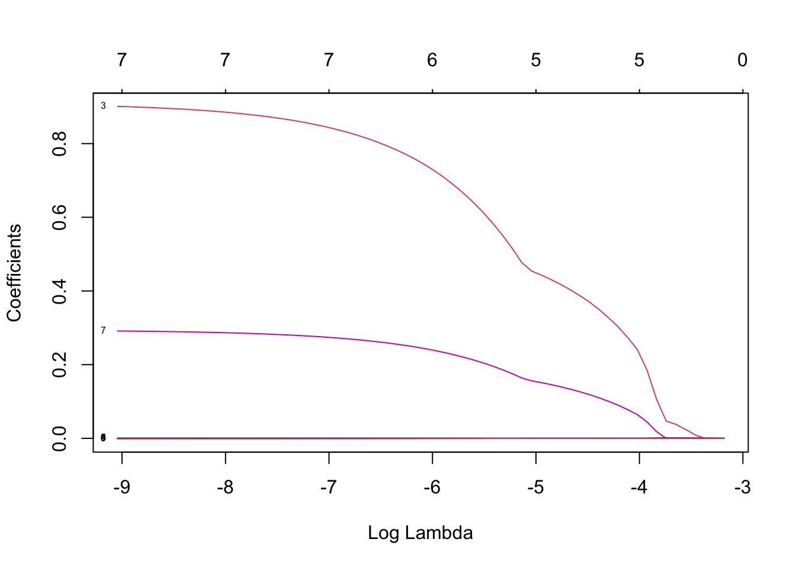
Lasso Regression Interpretation (Lambda Plot)
Coefficient Shrinkage: as the lambda increases, the absolute values of the coefficients shrink go more towards 0, which is actually the primary feature of Lasso regression. This shows the sparsity enforcement by shrinking is less important coefficients to zero.
Variable Selection:
At higher values of lambda (left side of the plot), more coefficients are non-zero, indicating that more variables are included in the model.
As lambda decreasing (move more to the right), fewer coefficients remain non-zero. This process effectively selects the most significant variables while penalizing less important ones.
Key Variable: the coefficients that remain non-zero even at higher values of log(lambda) (far left) are the most significant variables e.g. the red line representing a coefficient around 0.8 at the far left shows that the variable remains important even with a strong penalty.
Optimal Lambda: the point where lines start approaching zero significantly indicates the region of optimal lambda values.

Slide 12
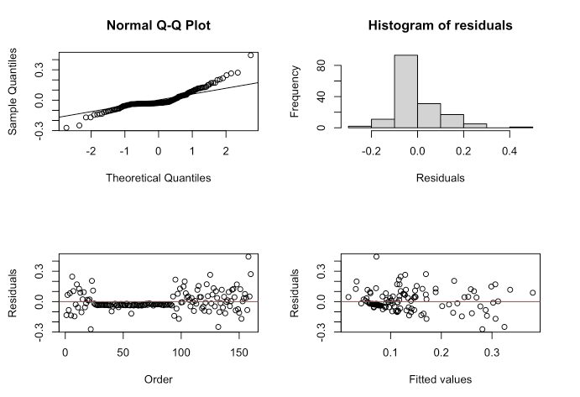
Visualization and Interpretation
The visualization of the forward stepwise regression model, the backward stepwise regression model, and Lasso regression mode have the same result as in the right side. Next, we will interpret the plots:
1. Normal Q-Q Plot:
The points follow the reference line closely, indicating that the residuals are approximately normally distributed. Even with some deviation at the tails, overall good fit.
2. Histogram of Residuals:
The residuals are centered around 0, with a lightly skew to the right and major residuals fall into the (-0.2 to 0.2). This can be implied that there are no major outliers or deviations from normality.
3. Residuals vs. Order Plot:
The residuals are randomly scattered around 0 and when more than 100, indicating that there is no discernible pattern over time, which mean that there is no autocorrelation in the residuals.
4. Residuals vs. Fitted Values Plot
The residuals are spread evenly around 0, without a clear pattern, which can be implied that the model has captured the relationship between the predictors and the response variable well. There is no evidence of heteroscedasticity.
Conclusion
To interpret this, we can see that the forward stepwise regression model, the backward stepwise regression model, and Lasso regression model fit the data well. The assumptions of normality, independence, and homoscedasticity of residuals are reasonably met. The model is appropriate for predicting the minimum distance between the comet and Earth (MOID) using the selected orbital elements.

Slide 13
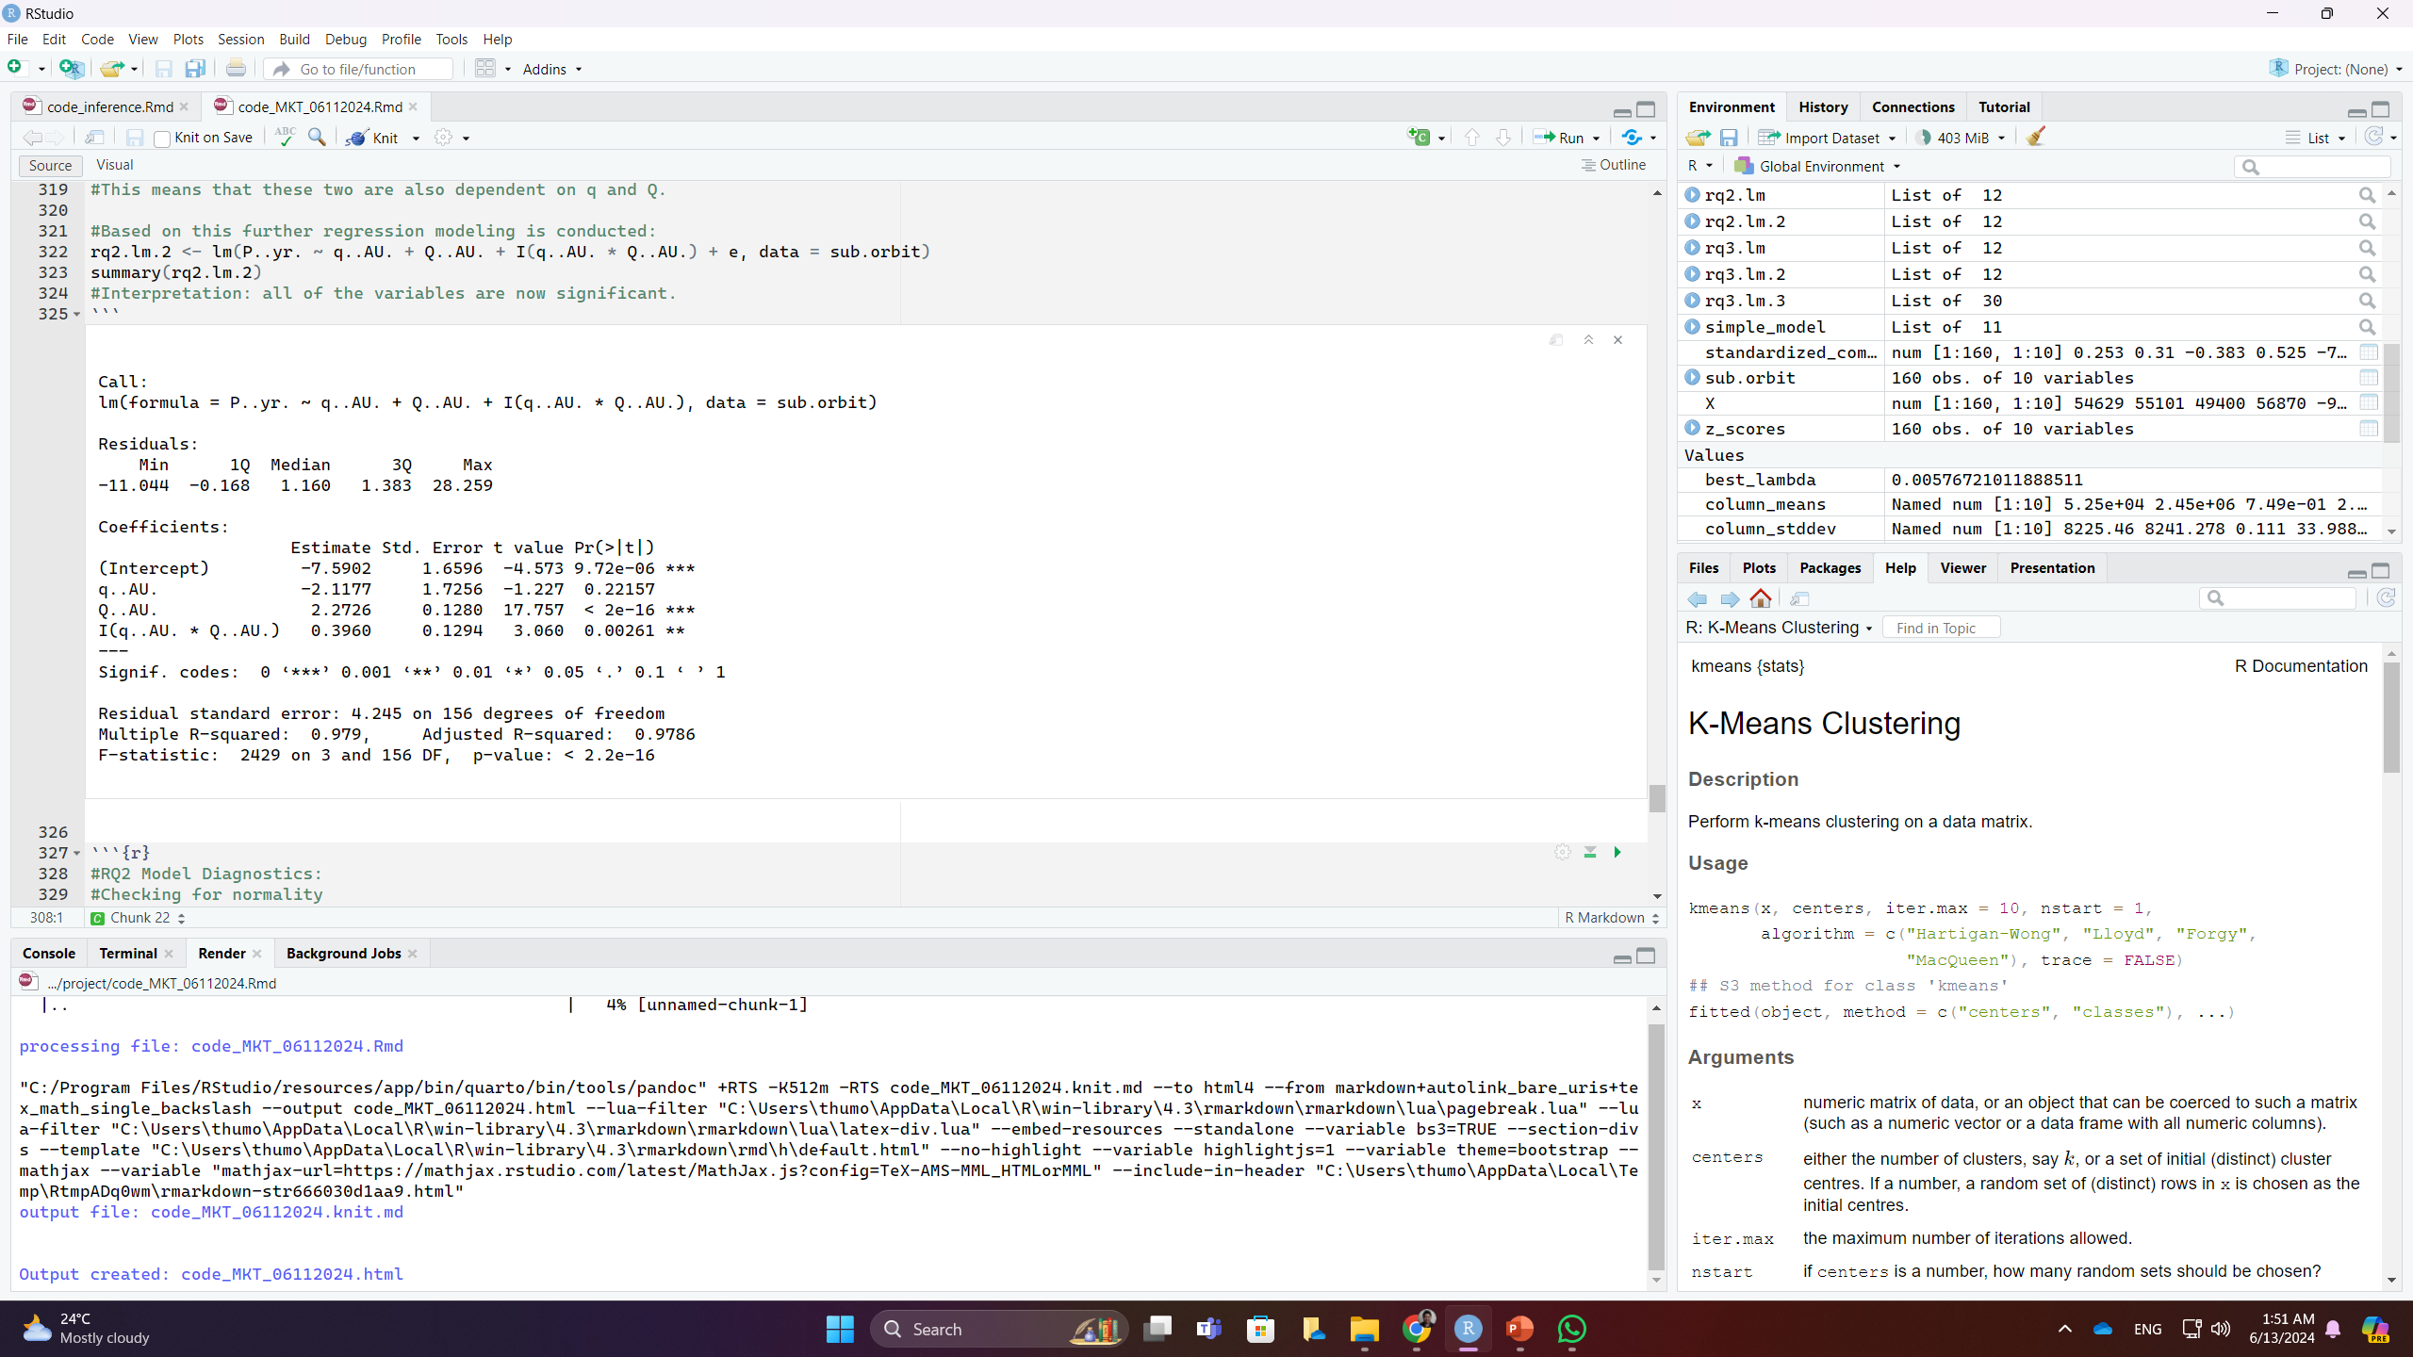
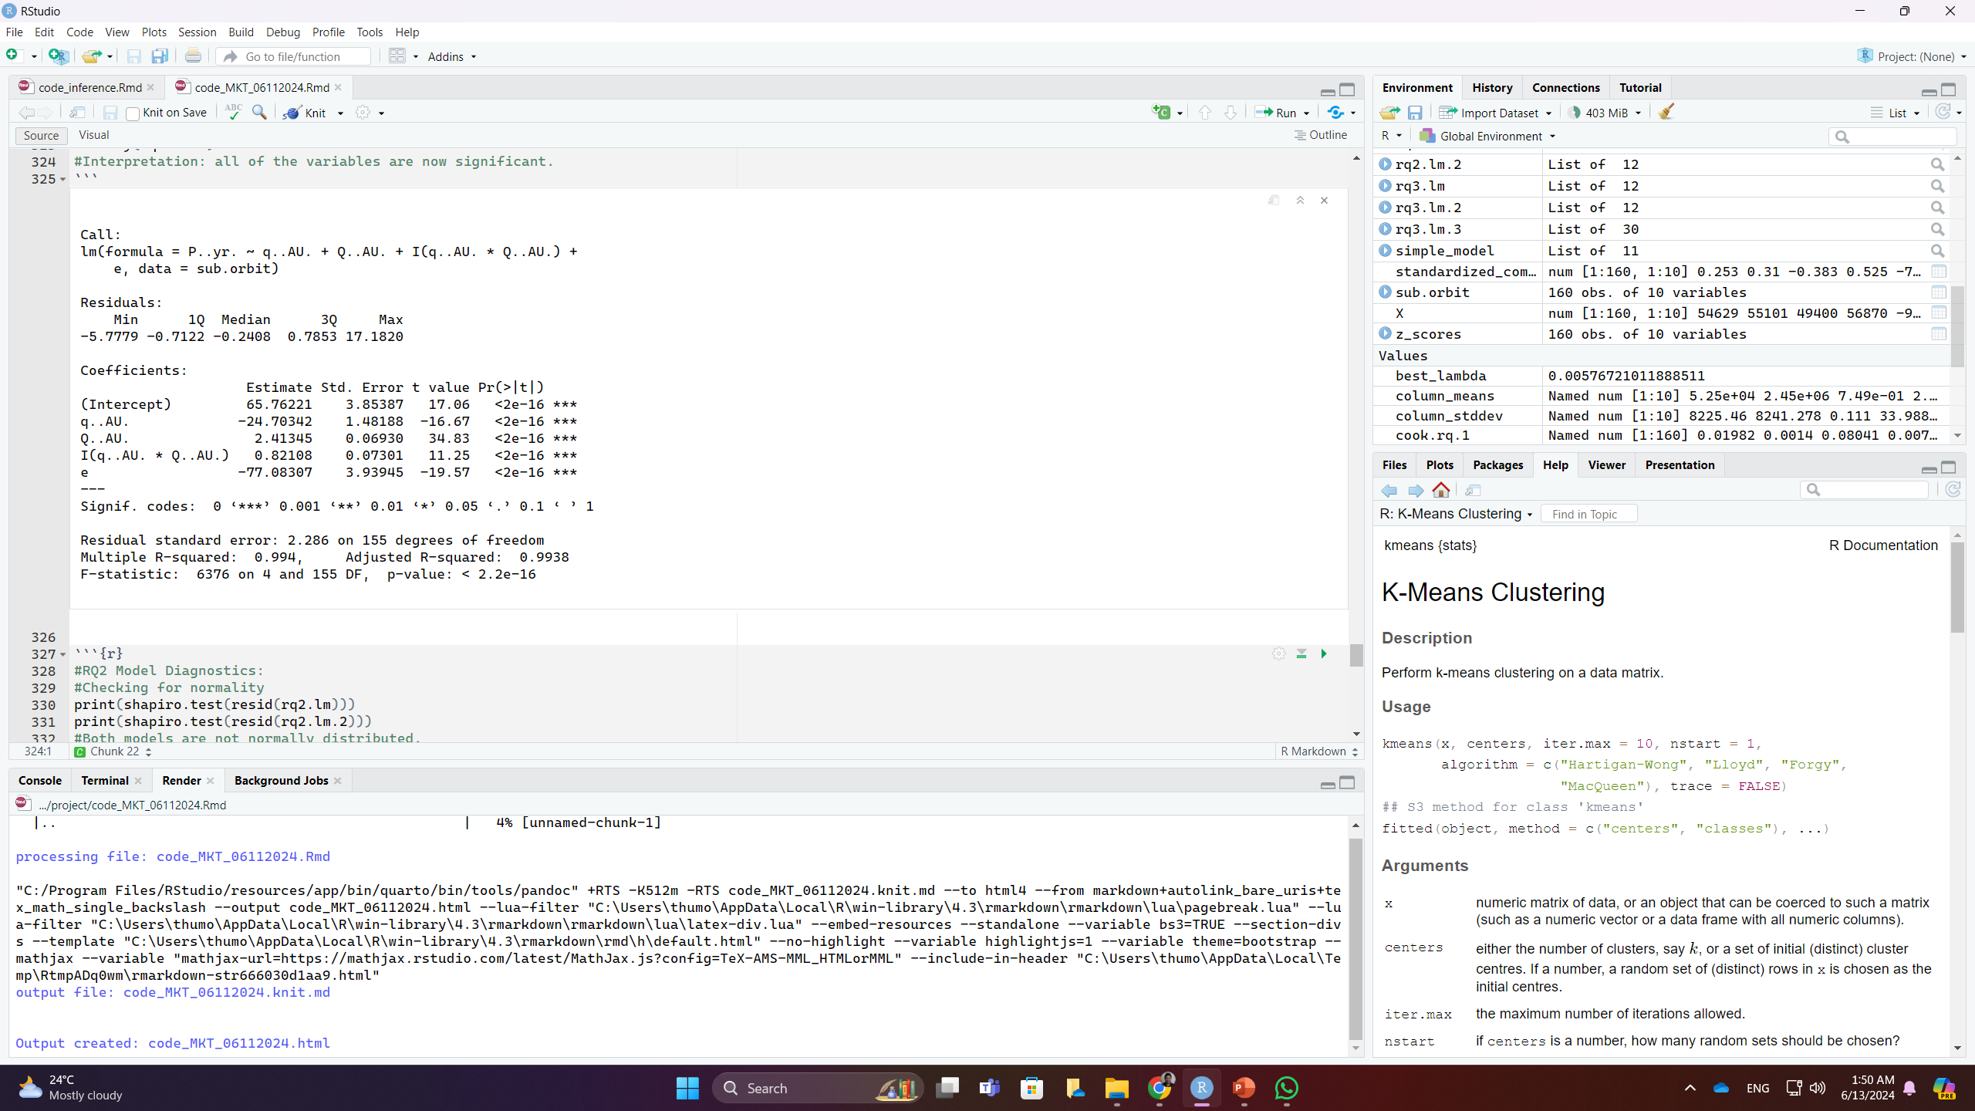
RQ2: Regression Modeling
We performed a regression analysis between P..yr. and minimum (q) and maximum (Q) distances along with interaction terms.
We found out that except for the minimum distance (q), the other two variables are significant, leading to correlation tests, where e has the highest correlation with both q and Q.
Second round of regression analysis shows that all variables are now significant predictors.
We further performed model diagnostics.
Normality: both models not normally distributed residuals
NCV: Presence of heteroskedasticity in both models
Multicollinearity (VIF): two multicollinearity in both models: Q and interaction term.
Cook’s Distance: 2 outlier observations at 159 and 123.

Slide 14
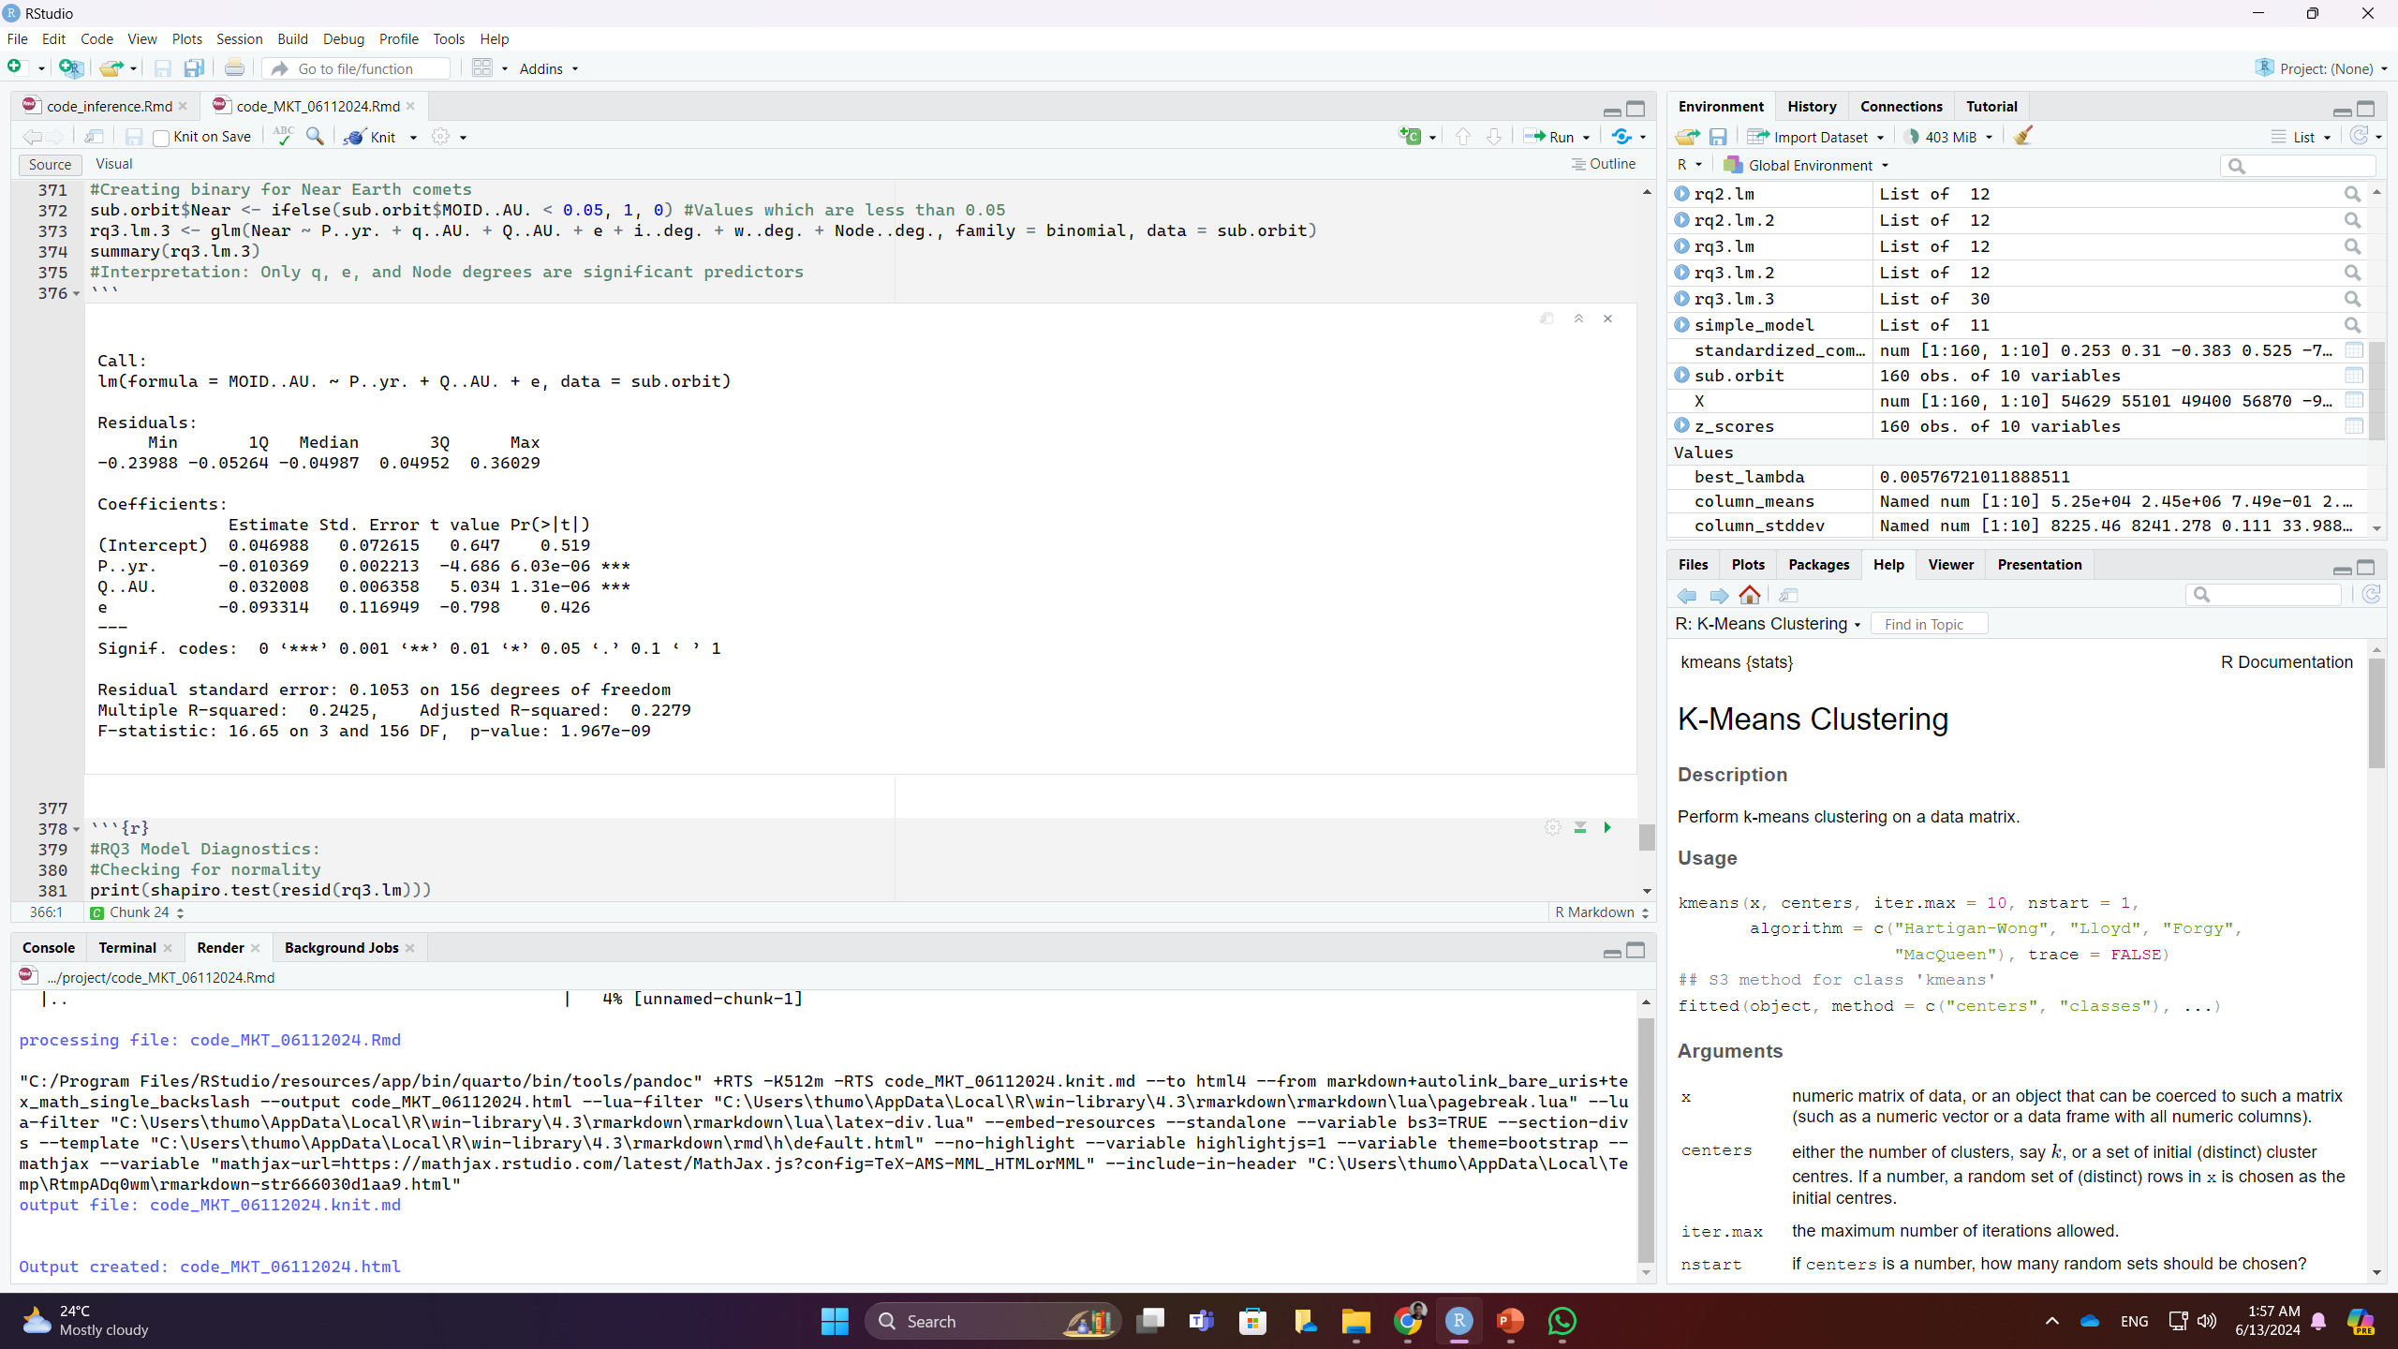
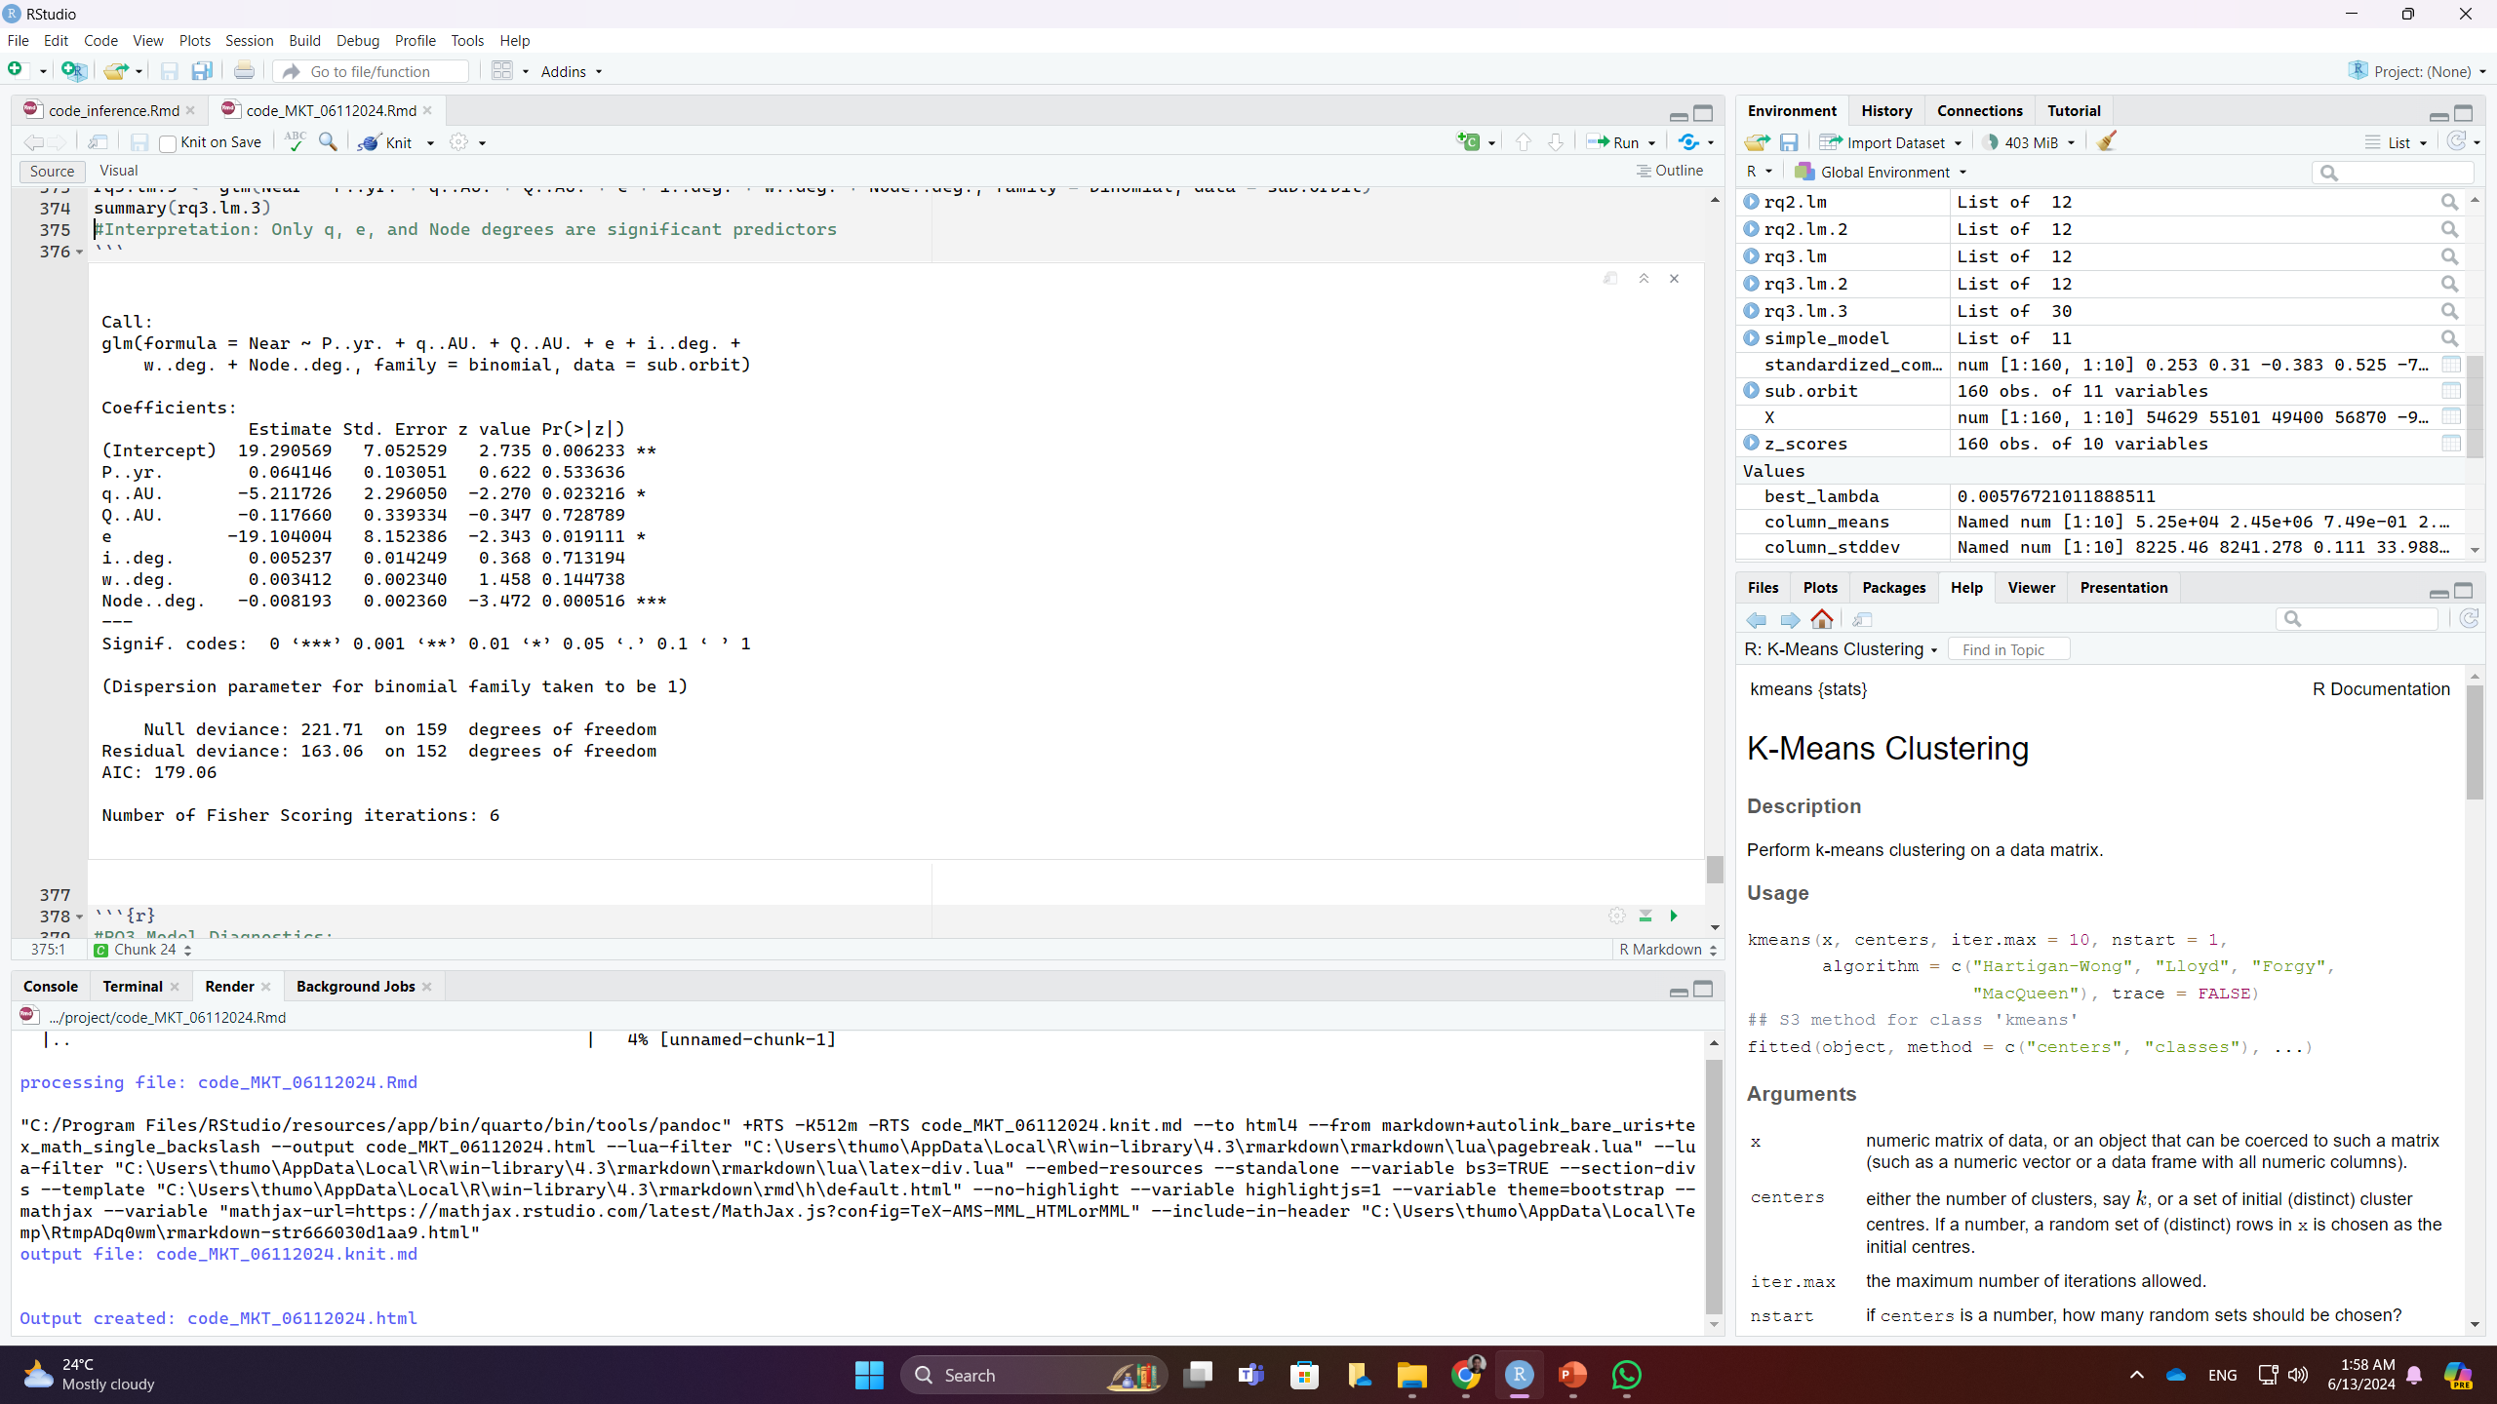
RQ3: Regression Modeling
We performed a regression analysis between MOID..AU. and P..yr. (model now shown) and results show high statistical significance.
Using correlation tests, the new model shows MOID..AU. has high correlation with P and Q..AU. and e, where P..yr. is highly correlated with Q and e.
Second regression shows that except for e, the other two variables are good predictors for MOID..AU.
Logistic regression is also performed for prediction by creating a new variable “Near”, where it is taken as 1 if values are less than 0.05 and 0 other wise.
Outcomes show that e, Node..deg., and q..AU. are all significant predictors.
We further performed model diagnostics for all three models
Normality: none of three models as not normally distributed residuals
NCV: Presence of heteroskedasticity in all three
Multicollinearity (VIF): two multicollinearity in both models: Q..AU. and P..yr. (no testing for model 1 since there’s only one variable)
Cook’s Distance: 2 outlier observations at 123 and 98 for all three

Slide 15
Conclusion
Orbital elements namely Eccentricity (e), argument of perihelion (w..deg.), longitude of ascending node (Node..deg.), perihelion distance (q..AU.), and orbital period (P..yr.) best predict the minimum distance between the comet and Earth (MOID); confirmed by LASSO and Stepwise Regressions.
Maximum distance (Q) and the interaction between minimum (q) and maximum (Q) distances significantly impact the orbital period (P) of the comet.
Significant correlation between MOID and P, although the coefficient outcome is low (0.0012), implying a weak relationship.
Logistic regression identified perihelion distance (q), eccentricity (e), and longitude of ascending node (Node..deg.) as significant predictors for determining the likelihood of a comet being a Near-Earth object (with MOID < 0.05).
Model diagnostics show the presence of issues with non-normality, heteroskedasticity, and multicollinearity although 3-4 outliers in general.

